Slide 1
CBD – What Faculty need to know for Internal Medicine
Jeannette Goguen, IM Program Director 2019-2020
Slideset originally created by Nicky Kraus, Lindsay Melvin and Rupal Shah 2018

Slide 2
Overview: Click where you want to go: CBD Overview Selecting EPAs Accessing Elentra Accessing DOM Resources Exit, any questions?

Slide 3
CBD Overview
Implications for learning and assessment

Slide 4
EPAs and assessment
EPA
Key tasks that a trainee can be entrusted to perform
Context and level specific
Assess
Snapshot in time
“Can I entrust this resident to perform this specific task without supervision?”
Depends on context, time in training, case complexity etc.
Example
EPA: Performing histories and physical exams, documenting and presenting findings, across clinical settings for initial and subsequent care (TTD, EPA 1)
EPA-based assessment: History for new patient with COPD
Notes:
You will be receiving a ton of information about CBD, EPA assessment, direct observation from Dr. Goguen as well as during meetings with your academic advisors. We will use examples to illustrate some of this terminology so that it makes sense.
Slide: Introduce EPA concept and related EPA based assessment (emphasize that assessment answers the question “can I entrust this resident with this specific task at this point in time?”) based on an entrustment scale

Slide 5
EPAs and assessment
Collated assessments (per EPA) = map of competence over time
Multiple assessors
Different contexts
Varying points in time
A single assessment = opportunity for feedback + coaching
Notes:
An individual EPA based assessment is an opportunity to get feedback and coaching directly from your supervisor. This is LOW STAKES meant to highlight areas in need of improvement and help trainee progress towards becoming competent to complete an EPA independently.
Residents are not expected to be entrustable each time an EPA is completed, this normally takes repeated effort to achieve.
Assessments collated across multiple assessors (i.e. different attendings), across contexts (i.e. different rotations), across time (i.e. early versus later blocks) provide a picture of whether or not a trainee is achieving a greater level of independence for a given EPA over time.

Slide 6
EPAs and assessment
Clinical Supervisor
Competence Committee
Coaching and feedback to trainee
Low-stakes observations
Synthesize data from many sources
Promotion decisions
http://www.royalcollege.ca/rcsite/cbd/assessment/committees/managing-competence-committees-e
Notes:
Emphasize the new relationship between supervisor and trainee – one of COACHING and FEEDBACK that is LOW-stakes
Decisions around promotion and sufficient competence is now made by the competence committee – and a single EPA-based assessment will feed into that promotion decision, in combination with a number of other sources of assessment (i.e. OSCE, simulation etc.)

Slide 7
EPAs and assessment
Expected trajectory
Notes:
Residents are not expected to be entrustable each time an EPA is completed, this normally takes repeated effort to achieve.
The purpose of EPA based assessments across contexts, supervisors and time is to document trajectory and identify residents in need of help earlier in training than with traditional educational models.

Slide 8
EPAs and assessment
Trainee
Clinical Supervisors
Competence Committee
Academic Advisors
Notes:
Each trainee has an academic advisor that will help them understand their trajectory, formulate individual learning plans to move along the competence continuum and guide the trainee with questions re CBD and EPA achievement.

Slide 9
Click where you want to go: CBD Overview Selecting EPAs Accessing Elentra Accessing DOM Resources Exit – Any questions?

Slide 10
Selecting EPAs: Which stage is the resident at now?
Notes:
Level specific

Slide 11
Which stage?
* We will review which EPA-based assessments should be completed on CTU for PGY1-PGY3,
PGY2 – PGY3
PGY1 (Blocks 5-13)
PGY1 (Blocks 1 -4)
Notes:
* Disclaimer --> there may be other EPAs that you will see on Elentra for your stage of training but we are specifically highlighting those that are relevant to CTU for PGY1-3 and clinics for PGY3. Other EPA’s may be completed, but this is a streamlined guideline.

Slide 12
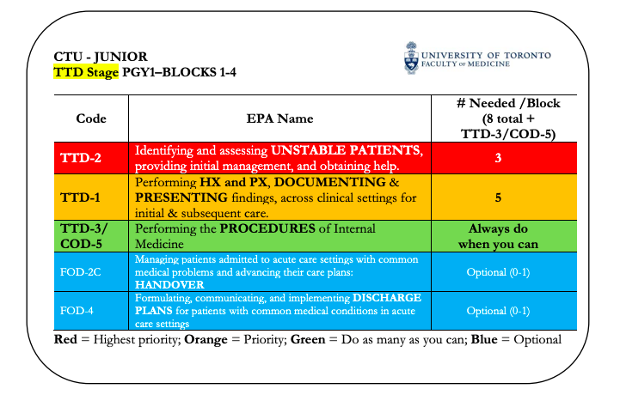
Which stage? PG1s : TTD
Notes:
**2 comments: COD5 is usually completed in PGY2-3 years; however, PGY1’s often have exposure to procedures early in training and opportunities to have these directly observed should be taken advantage of. We only included the procedures that PGY1’s are likely to see on CTU – but there are other procedures included in this EPA.
***Resident Primers include details about the number of successful EPA assessments, requirement for direct observation, number of faculty that need to complete an assessment and clinical settings in which these EPAs need to be observed. Please review this primer at the start of each block, and refer back to it periodically to ensure you are on track for EPA assessment.

Slide 13
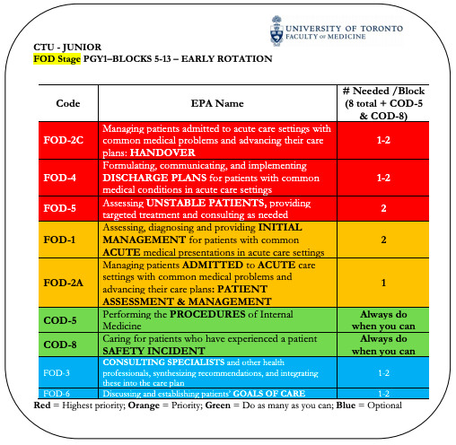
Which stage? PG1s : FOD
Notes:
**2 comments: COD5 is usually completed in PGY2-3 years; however, PGY1’s often have exposure to procedures early in training and opportunities to have these directly observed should be taken advantage of. We only included the procedures that PGY1’s are likely to see on CTU – but there are other procedures included in this EPA.
***Resident Primers include details about the number of successful EPA assessments, requirement for direct observation, number of faculty that need to complete an assessment and clinical settings in which these EPAs need to be observed. Please review this primer at the start of each block, and refer back to it periodically to ensure you are on track for EPA assessment.

Slide 14
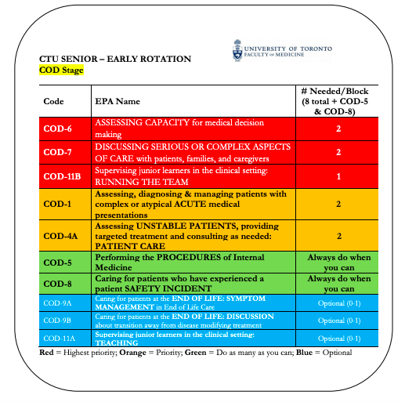
Which stage? PGY2s, 3s COD
*** Please review the FOD Resident Primer sent by Dr. Goguen for details!

Slide 15
Which EPA to do? http://uoft.me/imcbd
1
2
Go to uoft.me/imcbd and find your rotation cards

Slide 16
But how?
Guidelines to completing EPA assessments

Slide 17
But how?
Learners review their Learner Schedule* Resident Primer for TTD Stage**
+/- EPA Primers**
Meet your learner and identify EPAs to complete
You review the EPA Primers
Plan
2 clinical EPAs per week
+ procedural EPAs whenever you can
*Emailed directly to each PGY1 and PGY2
**on the DoM website uoft.me/imcbd
Notes:
Make a plan. Make it regular → e.g. Complete an EPA for the first admission on every post-call day, or have an EPA observation on Wednesdays at 1pm

Slide 18
But how?
Type of assessment
Direct observation
Indirect observation
Simulation
Direct observation
‘Partial’ tasks
E.g. reviewing discharge summary and plan with patient
Notes:
Direct observation – not practical to watch a full history and physical (for example) so should be focused on partial tasks
Indirect observation – case review, team round discussion, chart review, discharge summary review etc.
Simulation – skills labs

Slide 19
But how?
Filling out forms
In the moment
With supervisor
Coaching
Not a secret!
Notes:
Fill out the forms shortly after the clinical assessment – in the moment Opportunity for the supervisor to provide immediate feedback and coaching
The feedback is formative and encouraged – ‘not a secret’

Slide 20
Click where you want to go: CBD Overview Selecting EPAs Accessing Elentra Accessing DOM Resources Exit – Any questions?

Slide 21
Accessing Elentra Practical tips!
What you need to know to get started

Slide 22
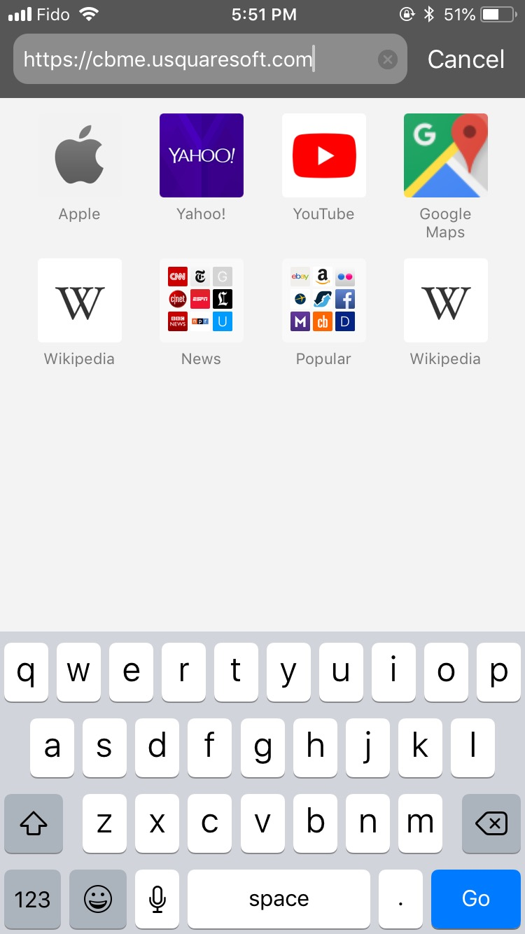
Practical tips
https://meded.utoronto.ca
Add to home screen
Notes:
Add Elentra to your home screen (for iPhone):
Open safari
Enter elentra website

Slide 23
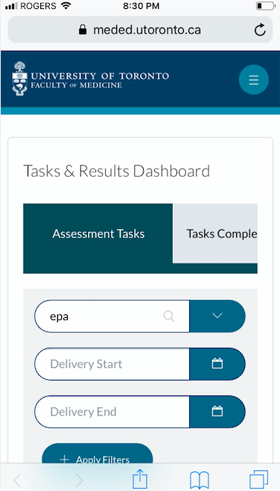
Practical tips
Add to home screen
Notes:
Add elentra to your home screen (for iPhone):
Click Share icon
Click Add to Home Screen

Slide 24
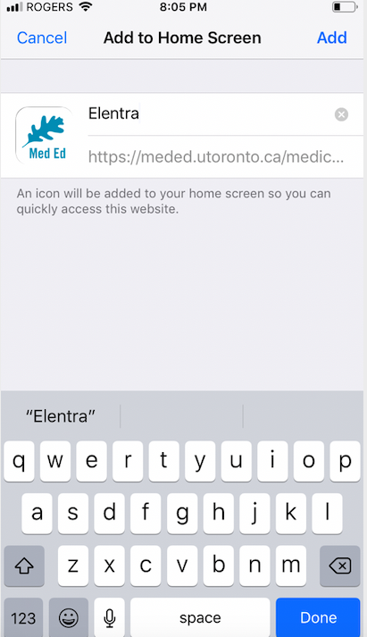
Practical tips
Add to home screen
Notes:
Add Elentra to your home screen (for iPhone):
Name new icon and click Add
Icon should now appear on your home screen

Slide 25
Practical tips Fill out a form on Elentra
https://pg.postmd.utoronto.ca/
Or go directly to: https://meded.utoronto.ca

Slide 27
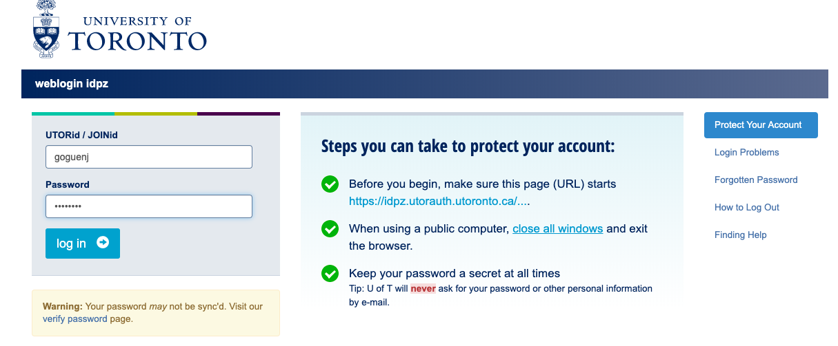

Slide 28
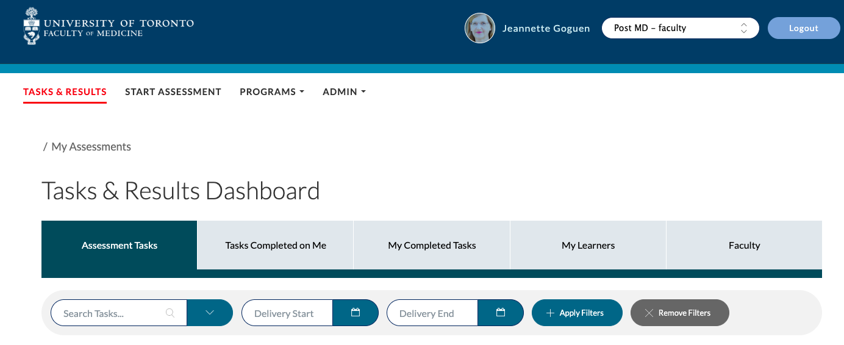
TASKS & RESULTS
START ASSESSMENT
TASKS & RESULTS
1
1
2
3

Slide 29
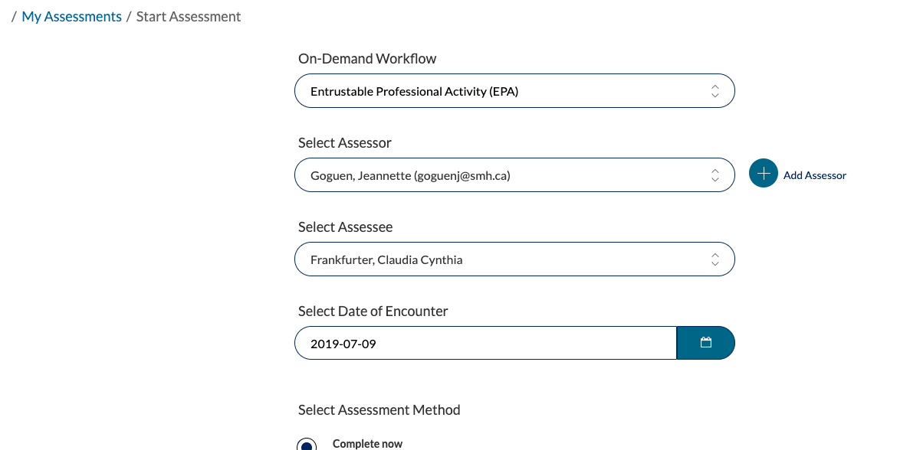
Lawrence, DH

Slide 30
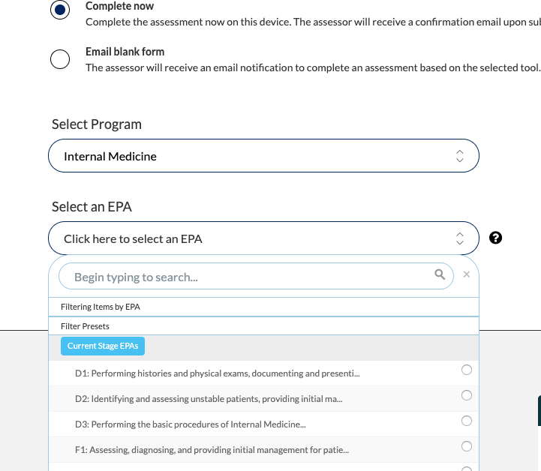

Slide 31
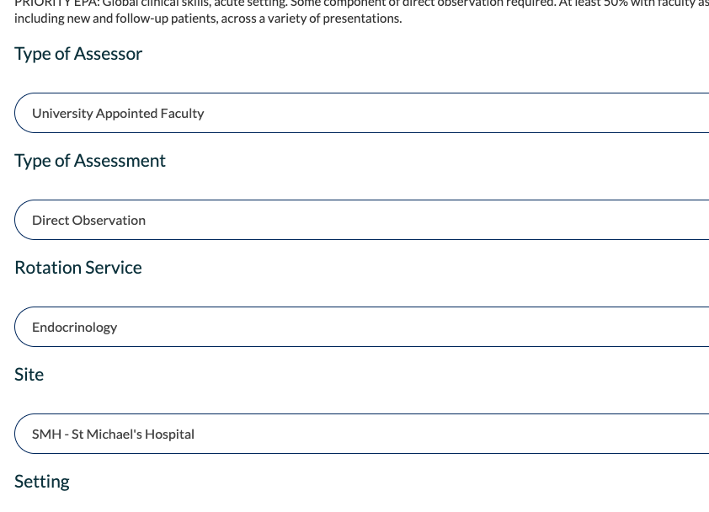

Slide 33
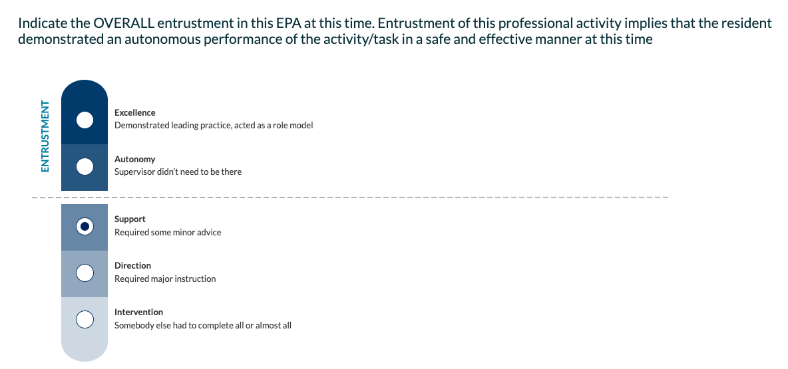

Slide 35
Click where you want to go: CBD Overview Selecting EPAs Accessing Elentra Accessing DOM Resources Exit – Any questions?

Slide 36
DOM CBD resources

Slide 37
Getting Started: FAQ
What do I need to know about TTD (Transition to Discipline)?
See Stage Primer
Which EPAs should the resident get done?
See Learner Schedule, Rotation cards, Curriculum Plan (redundant)
Where do you find the forms?
Dom website: EPA Primers for information
Elentra: to complete assessment on actual form
How many do they need to do? 2 each week
Who starts the process, you or the resident? Both!

Slide 38
Transition to Discipline TTD Stage Primer provides an overview of the stage http://www.deptmedicine.utoronto.ca/sites/default/files/Resident Primer - Transition to Discipline.pdf

Slide 39
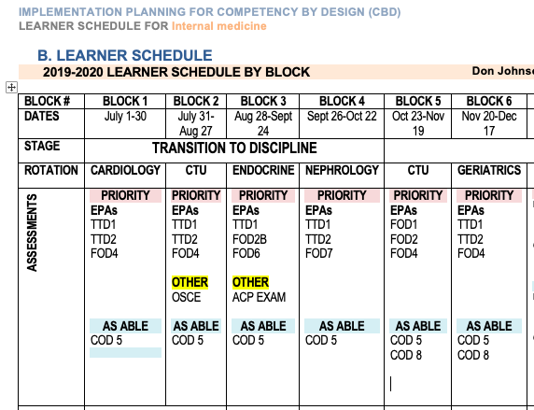
Check out your Learner Schedule
Each Resident’s
personal
Learner Schedule
indicates which
EPAs to complete
each rotation

Slide 40
The Rotation Cards are also very helpful!
The Rotation card
tells us
which EPAs
to complete
on a particular
Stage and a
particular rotation
http://uoft.me/imcbd

Slide 41
The Curriculum Plan gives an overview of which EPAs to complete each rotation http://uoft.me/imcbd

Slide 42
EPA Primers give more information about each EPA
http://uoft.me/imcbd

Slide 43
Click where you want to go: CBD Overview Selecting EPAs Accessing Elentra Accessing DOM Resources Exit – Any questions?

Slide 44
Let us know if you have any questions: im.cbd@utoronto.ca or
jeannette.goguen@utoronto.ca

